Slide 1


DONE BY:
Aditya Zalpuri (2021A1R057)
Ankush Raina (2021A1R059)
Sparsh Sharma (2021A1R056)
Kanav Sharma (2021A1T055)
Shradha Sharma (2022A1L016)

Slide 2
PROBLEM STATEMENT - 4
TITLE
Simulating Linux Terminal File Explorer functionality using special keys, basic commands and open files features.

Slide 3
Objective
Normal Mode of Execution
Files should be displayed alphabetically using explorer.
Scrolling : 1 file scrolled at a time. Use a special key ‘j' for scrolling down, 'k' for scrolling up.
Opening files should be done in their default apps.
Back and forward implemented the same as we observe in the Linux GUI file explorer app.
Assumed : application home should be given while running the program.

Slide 4
Objective
Command Mode
If changes are made in the current dir (shown currently on terminal), the changes would be updated (on terminal) when the user comes out of the command mode by pressing ESC.
Goto would update the terminal with a new path immediately.
All paths would be relative to Application home.

Slide 5
Topics covered
What is file explorer ?
Why use file explorer ?
Our project
Flowchart
Algorithm
Code
Implementation

Slide 6
What is file explorer ?
It is a file manager application.
It provides a graphical user interface for accessing the file systems.
It provides functions such as create, delete, move and copy a file.
You can access any file on the system using file explorer.

Slide 7
Why use file explorer ?
It is easy to use which makes it User friendly.
It helps keep everything organised.
It gives you control over information access.
It increases efficiency.

Slide 8
Our project
DESCRIPTION
Our aim is to develop a program that displays the file system on the terminal.
Which helps users navigate through it using special keys.
It also open files and execute basic file commands

Slide 9


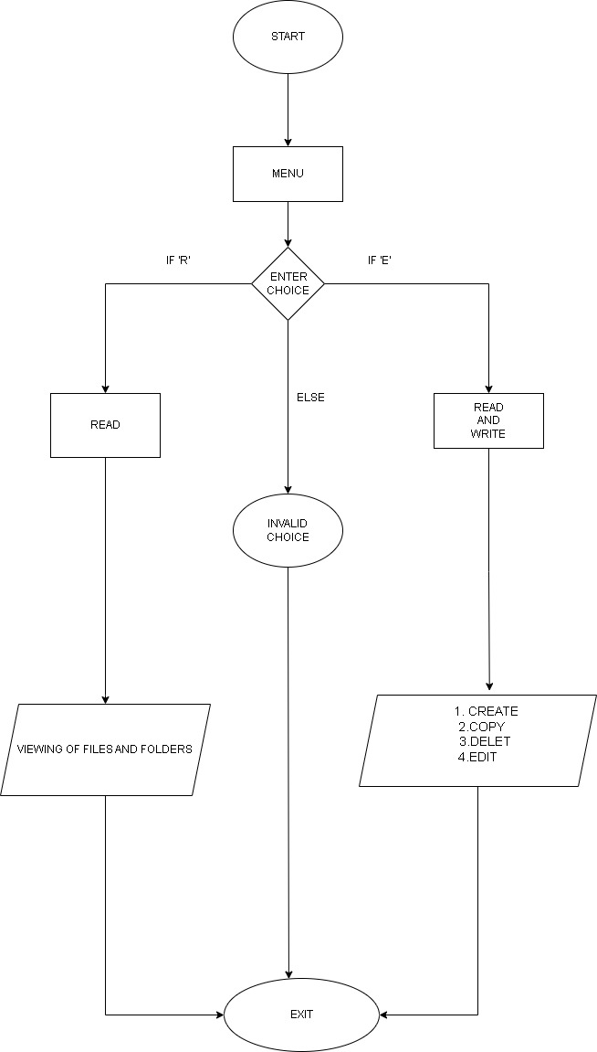

Flow chart

Slide 10
Working
The File Explorer displays
File/Folder
Provides Functions Like:
Delete
Display
Edit The File
Move To The Directory
Scroll Up and Down

Slide 11

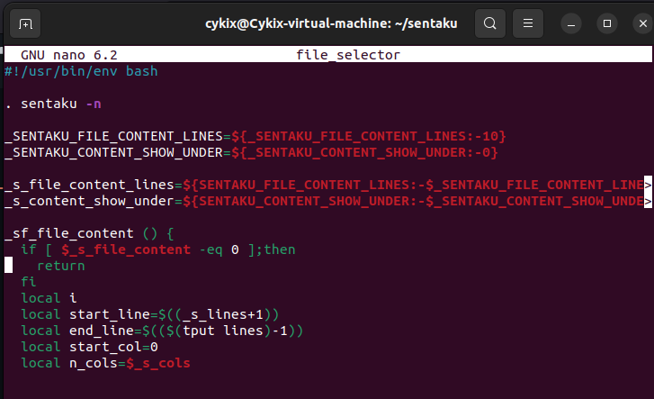

Normal Mode
Code

Slide 12
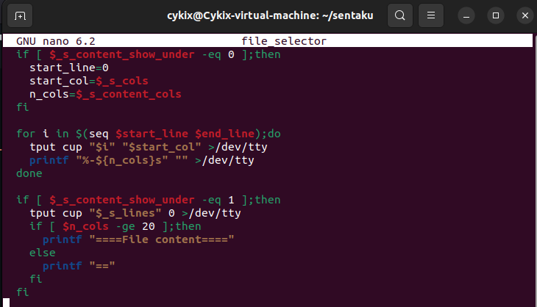
Normal Mode Code

Slide 13
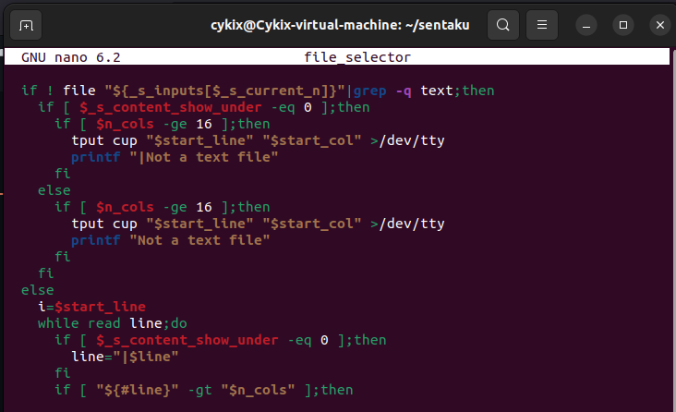
Normal Mode Code

Slide 14
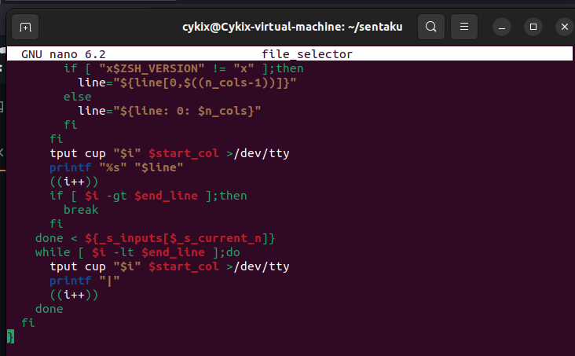
Normal Mode Code

Slide 15
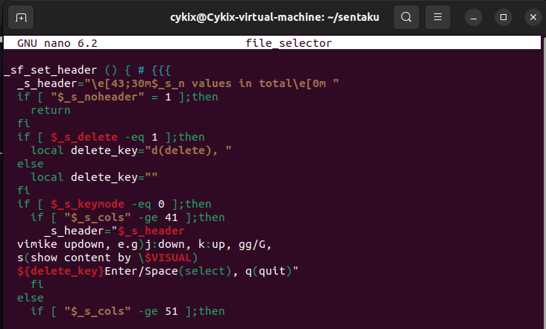
Normal Mode Code

Slide 16
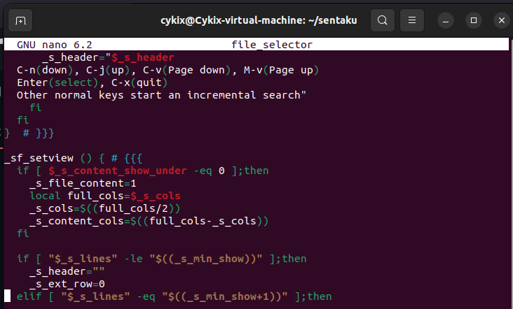
Normal Mode Code

Slide 17
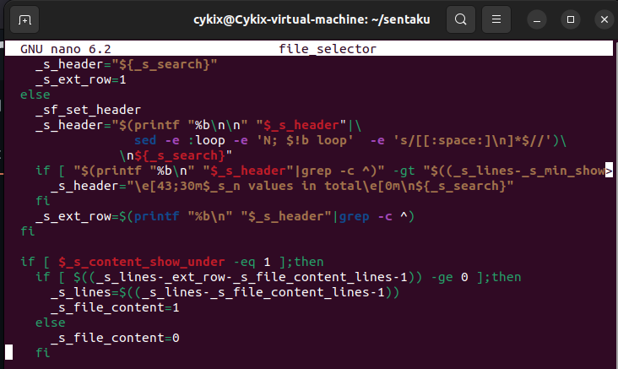
Normal Mode Code

Slide 18
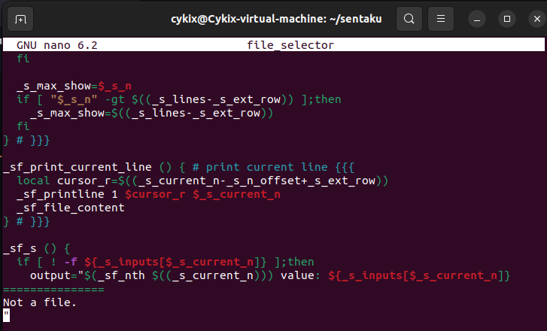
Normal Mode Code

Slide 19
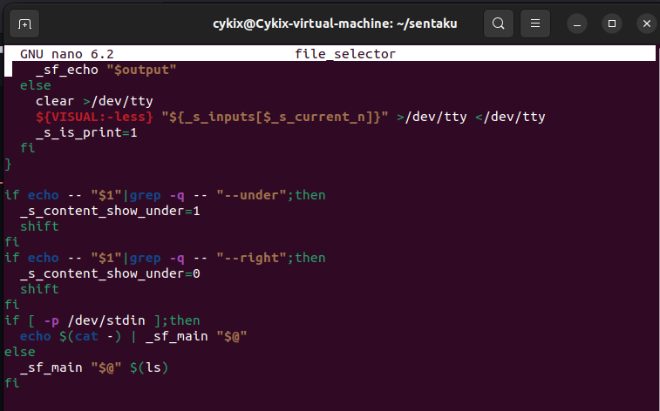
Normal Mode
Code

Slide 20
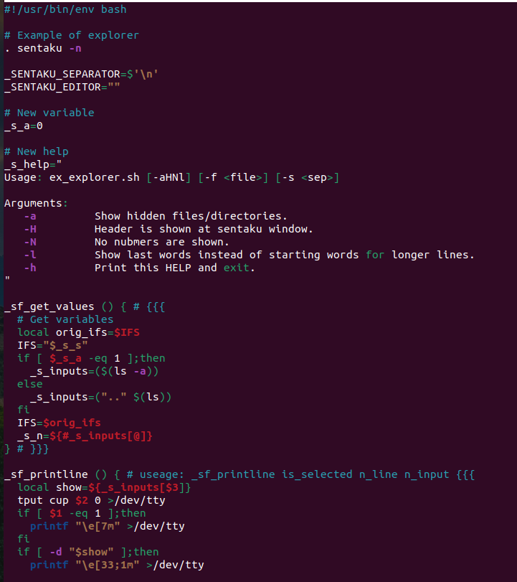
Command Mode Code

Slide 21
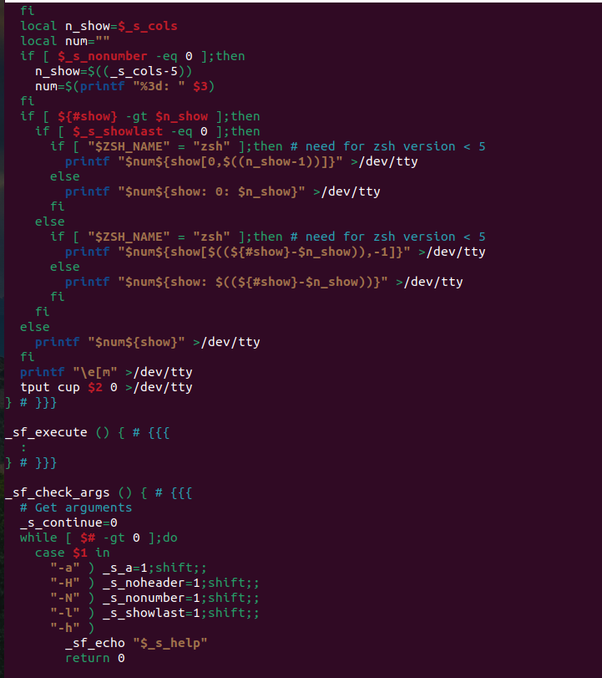
Command Mode Code

Slide 22
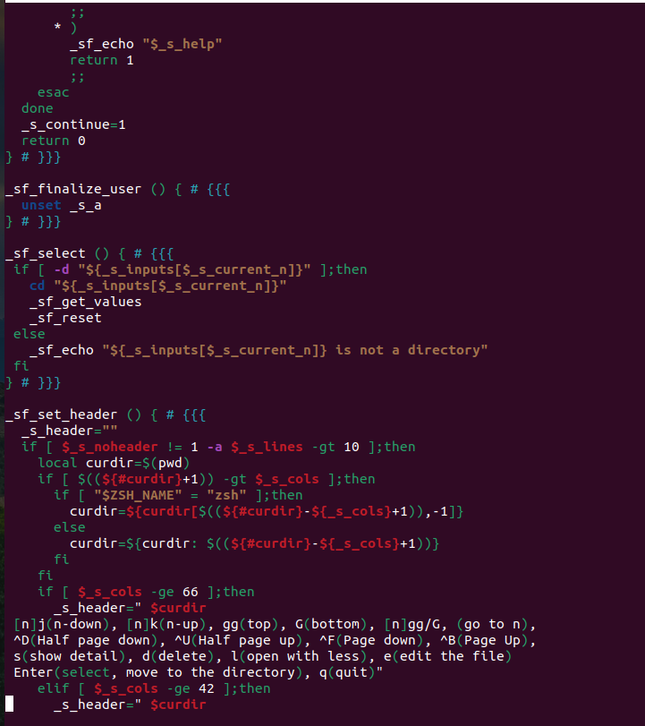
Command Mode Code

Slide 23
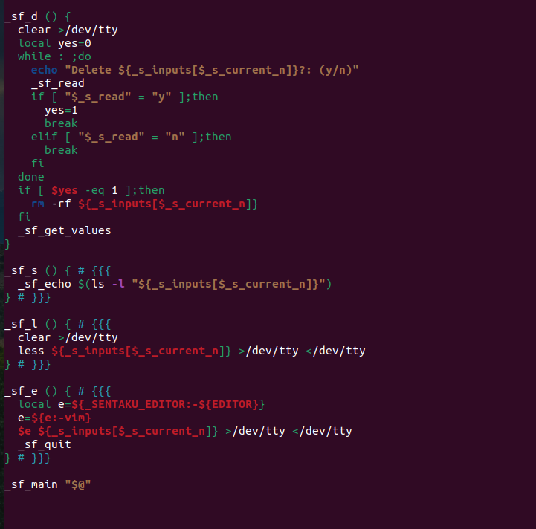
Command Mode Code

Slide 24
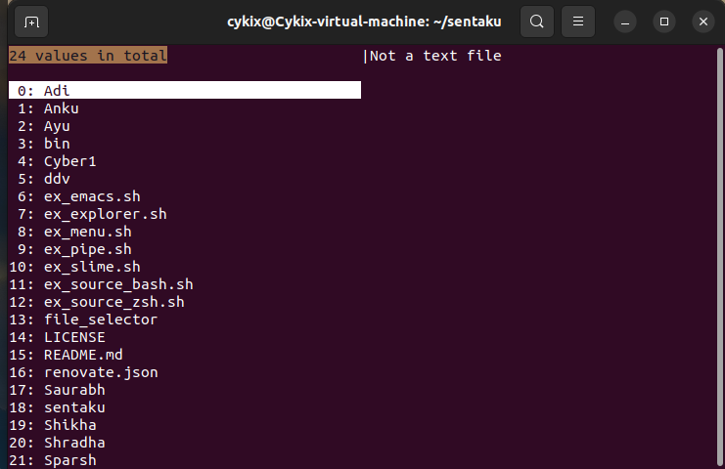
Implementation Normal Mode(View only)

Slide 25
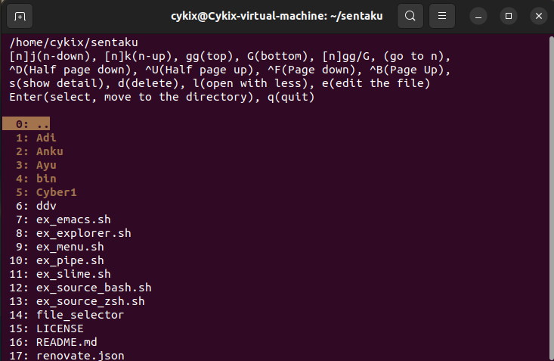
Implementation Command mode(Editing)

Slide 26
References
https://github.com/rcmdnk

Slide 27


